Slide 1


What tidyverse can tell us about the data without prior industry knowledge?
Case study: Consumer attitude towards fish sauce products
Xuan Pham – Quan Tran
Dataset is provided by Mr. Le Minh Tam, HUFI, Vietnam.

Slide 2
Import
Communicate
Model
Visualise
Tidy
Transform

Slide 3









Transform
Visualise
Import
Tidy
Communicate
Model

Slide 4

Case study: Consumer attitude towards fish sauce products
Output:
http://rpubs.com/monkey08091992/tidyverse001
http://rpubs.com/monkey08091992/tidyverse002
Source code:
https://github.com/ptlxuan89/tidyverse_201912

Slide 5
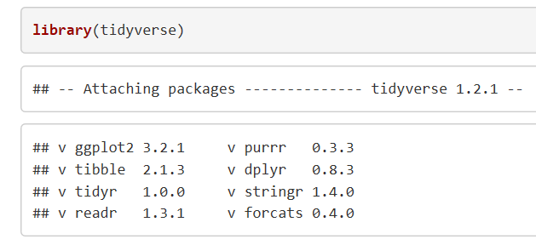

Slide 6
Import
read_csv()
%>%
Tidy
gather() ; spread()
%>%
Transform
filter(); select(); arrange(); mutate(); summarise(); group_by()
%>%
Visualise
ggplot(data, aes(x,y)) + geom_*()

Slide 7

%>%

Slide 8
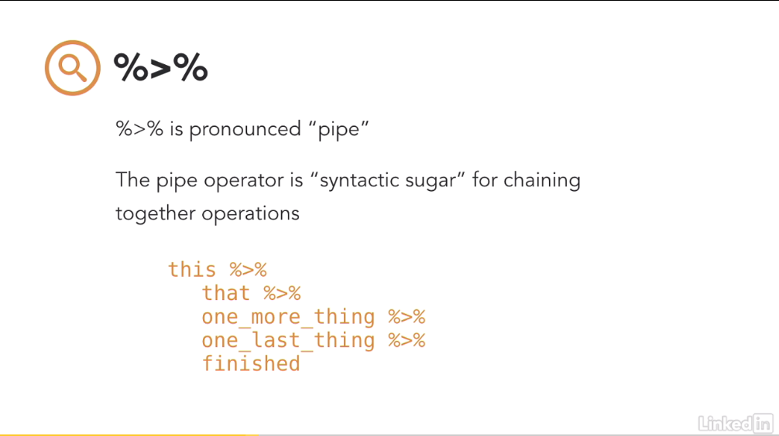

Slide 9
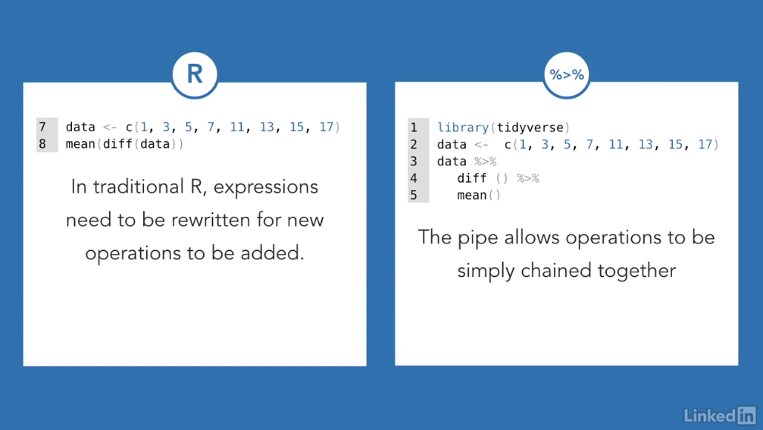

Slide 10
IMPORT DATA
 | readr | readxl
Generic Function | read_csv(filename) | read_excel(filename, sheetname)

Slide 11
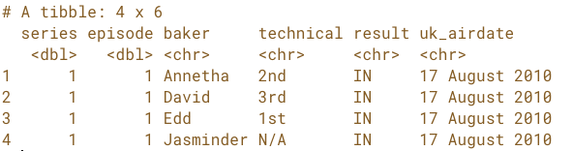
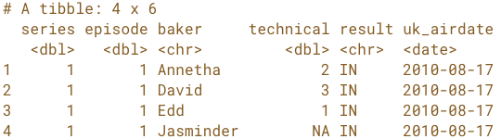
IMPORT DATA
READ_CSV() NO ADDITIONAL ARGUMENTS | TAMING DATA WITH SPECIFIC COL_TYPE AND NA ARGUMENTS
desserts <- read_csv("desserts.csv”) | desserts <- read_csv("desserts.csv", col_types = cols(uk_airdate = col_date(format = "%d %B %Y"), technical = col_number()), na = “N/A”)

Slide 12
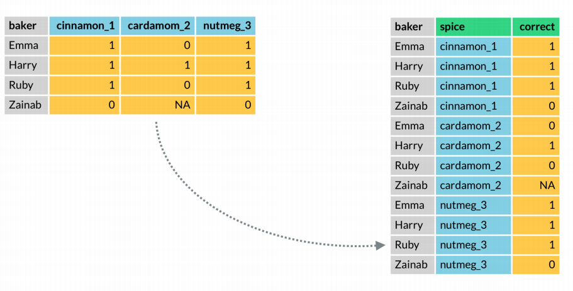
TIDY DATA – gather()
dataset %>% gather(key = “spice”, value = “correct”, cinnamon_1:nutmeg_3)
Notes:
moves column names into a key column, gathering the column values into a single value column

Slide 13
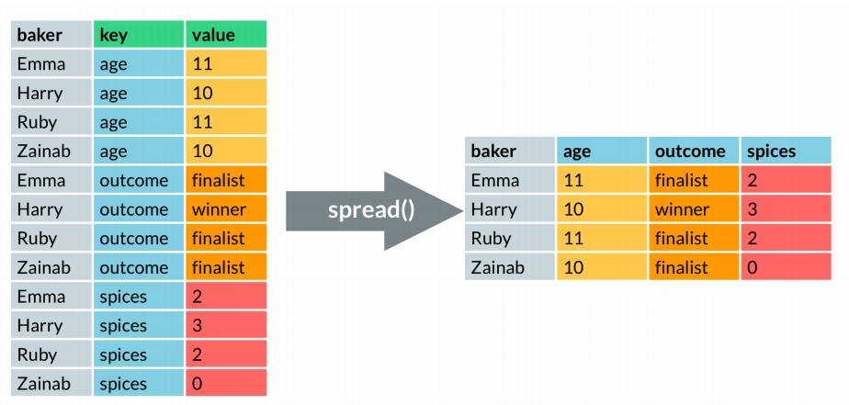
TIDY DATA – spread()
dataset %>% spread(key = key, value = value)
Notes:
moves the unique values of a key column into the column names, spreading the values of a value column across the new columns

Slide 14
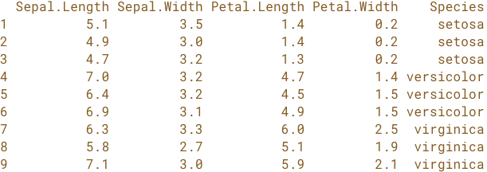



TRANSFORMATION – 5 KEY FUNCTIONS
Select rows of Iris to create small subset to illustrate the usage of 5 key functions:
s_iris <- iris %>%
slice(1:3, 51:53, 101:103)
FUNCTION | USAGE | IRIS EXAMPLE OUTPUT
filter() | s_iris %>% filter(Species %in% ”setosa”)
arrange() | s_iris %>% filter(Species %in% ”setosa”) %>% arrange(desc(Sepal.Length))
select() | s_iris %>% filter(Species %in% ”setosa”) %>% select(Petal.Length:Petal.Width)

Slide 15

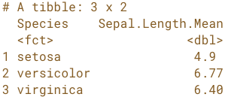
TRANSFORMATION – 5 KEY FUNCTIONS
Select rows of Iris to create small subset to illustrate the usage of 5 key functions:
s_iris <- iris %>%
slice(1:3, 51:53, 101:103)
FUNCTION | USAGE | IRIS EXAMPLE OUTPUT
mutate() | s_iris %>% filter(Species %in% ”setosa”) %>% select(Petal.Length) %>% mutate(Petal.Length.millimeter = Petal.Length * 10)
summarise() | s_iris %>% group_by(Species) %>% summarise(Sepal.Length.Mean = mean(Sepal.Length))

Slide 16
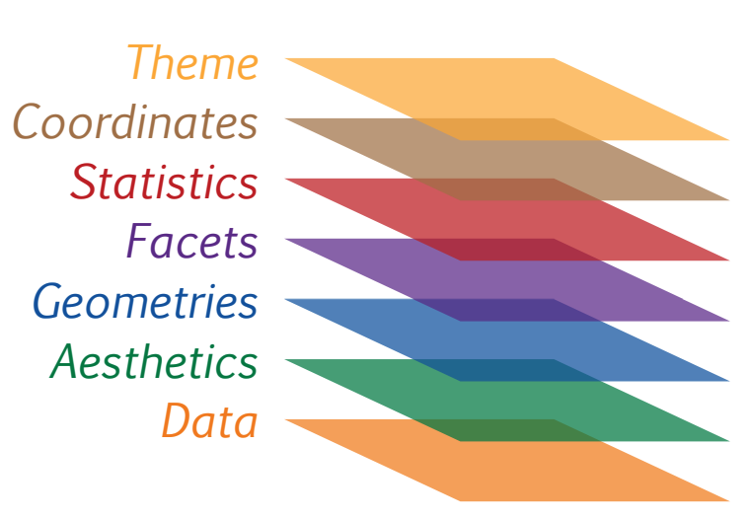
VISUALIZATION WITH GGPLOT2 – WHY?
Layered Grammar of Graphics
A tool that enables us to concisely describe the components of a graphic through layers
(Hadley Wickham)
Theme: theme of the graph
Coordinates: the coordinate system of the graph
Statistics: to provide statistical representation of our plot
Facets: small multiples, create separate graphs for subsets of data
Geometries: actual marks we put on the plot (point, lines, boxplot, …)
Aesthetics: “which” variable to be mapped into the plot
Data: the dataset used in plotting
Notes:
ggplot2 is based on the grammar of graphics, the idea that you can build every graph from the same few components: a data set, a set of geoms—visual marks that represent data points, and a coordinate system

Slide 17
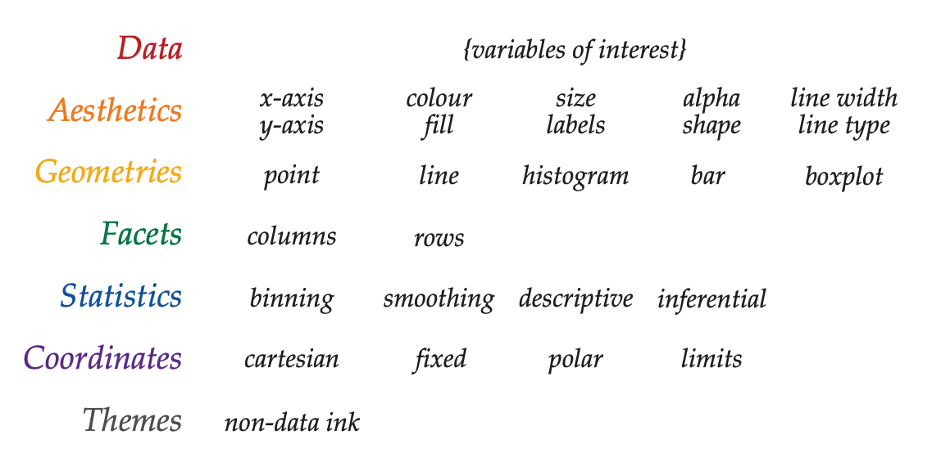
VISUALIZATION WITH GGPLOT2
What To Put on Each of the Layers?
Each layer takes different input of data variables
GENERIC FUNCTION:
ggplot(data, aes(x, y, fill, col)) +
geom_*() +
facet_*() +
stat_*() +
coord_*() +
theme_*()
Notes:
ggplot2 is based on the grammar of graphics, the idea that you can build every graph from the same few components: a data set, a set of geoms—visual marks that represent data points, and a coordinate system

Slide 18

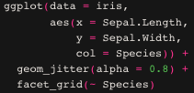
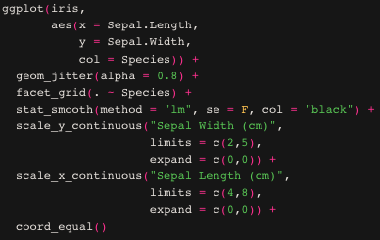
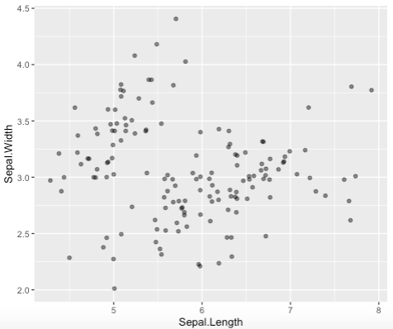
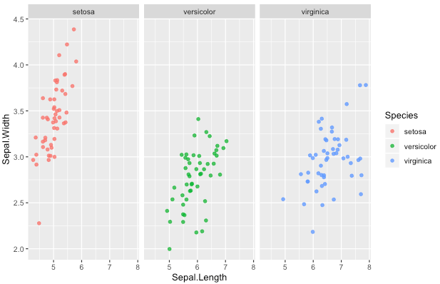
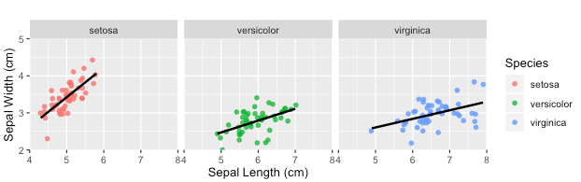
GGPLOT2 – IRIS EXAMPLE
Data + Aesthetic + Geometrics | Data + Aesthetic + Geometrics + Facets | Data + Aesthetic + Geometrics + Facets + Statistic + Coordinate
Notes:
ggplot2 is based on the grammar of graphics, the idea that you can build every graph from the same few components: a data set, a set of geoms—visual marks that represent data points, and a coordinate system

Slide 19
BẢNG CÂU HỎI
Phần A: Các yếu tố ảnh hưởng đến quyết định mua nước mắm (sức khỏe, cảm nhận, truyền thống, chất lượng, giá, sự tiện lợi)
Phần B: Các yếu tố quan trọng khi chọn mua nước mắm
Phần C: Hành vi và thói quen tiêu dùng nước mắm (Nhãn hiệu, bao bì, tần xuất)
Thông tin cá nhân: Tuổi, giới tính, quê quán, trình độ học vấn và tình trạng nghề nghiệp

Slide 20
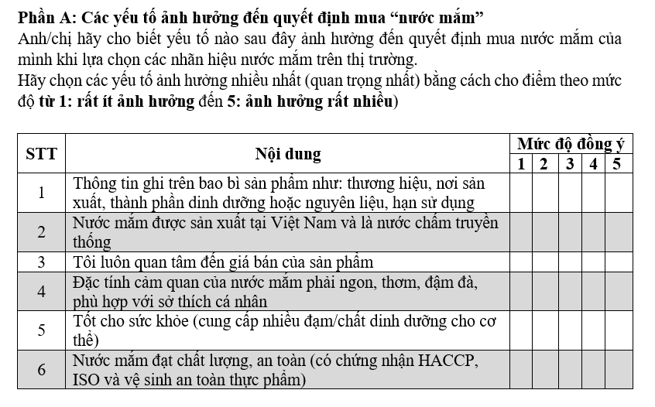

Slide 21
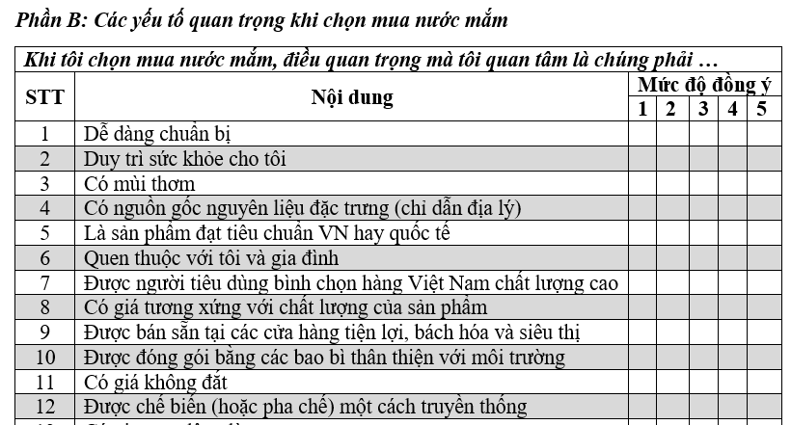

Slide 22
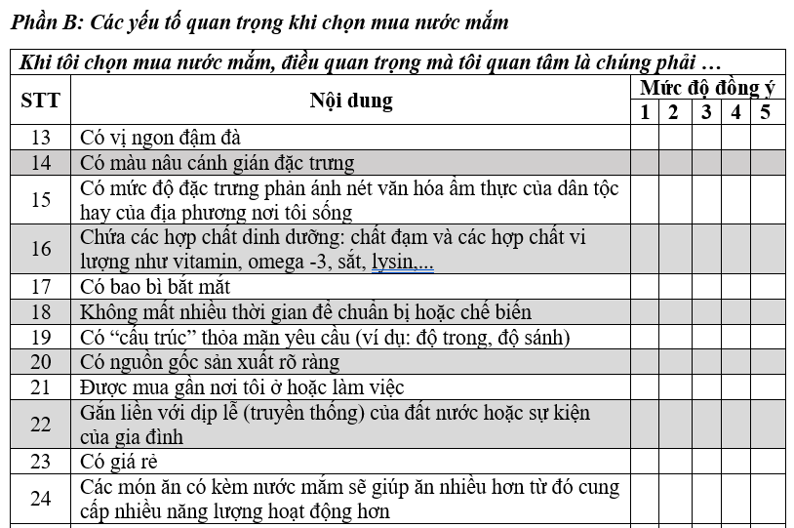

Slide 23
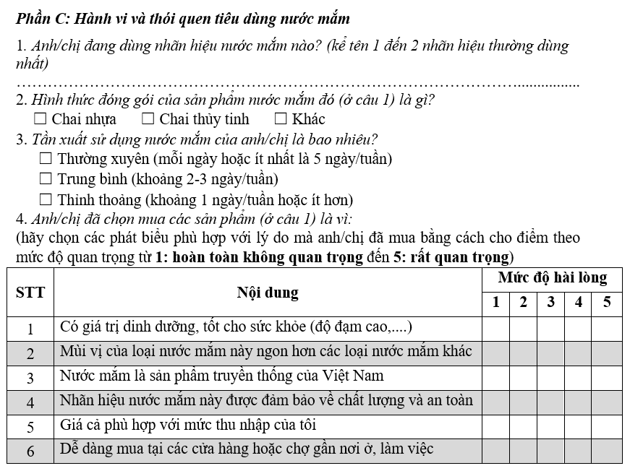

Slide 25
Thank you

